Slide 1













NOTES SHARING APP DJANGO FRAMEWORK
ACADEMIA
ALOK RAJ HANS
(P-10)
FSWD

Slide 2
Problems !
ACADEMIA
So many WhatsApp group for different subjects?
It is taking a lot of time to find the desired notes?
Scrolling though the notes to see which one is that you want?
For accessing notes you have to go through this process again and again?

Slide 3

NOTES SHARING APP homepage
ACADEMIA

Slide 4
TABLE OF CONTENTS
ACADEMIA
REGISTER/SIGN UP
LOGIN IN
01
02
Register as a Student or Teacher
Log in with email and password credential
STUDENT DASHBOARD
TEACHER DASHBOARD
03
04
Includes all information of student with the notes shared by respective teacher
Includes all information of student with the field where notes can be uploaded

Slide 5


REGISTER/SIGN UP
ACADEMIA
01

Slide 6
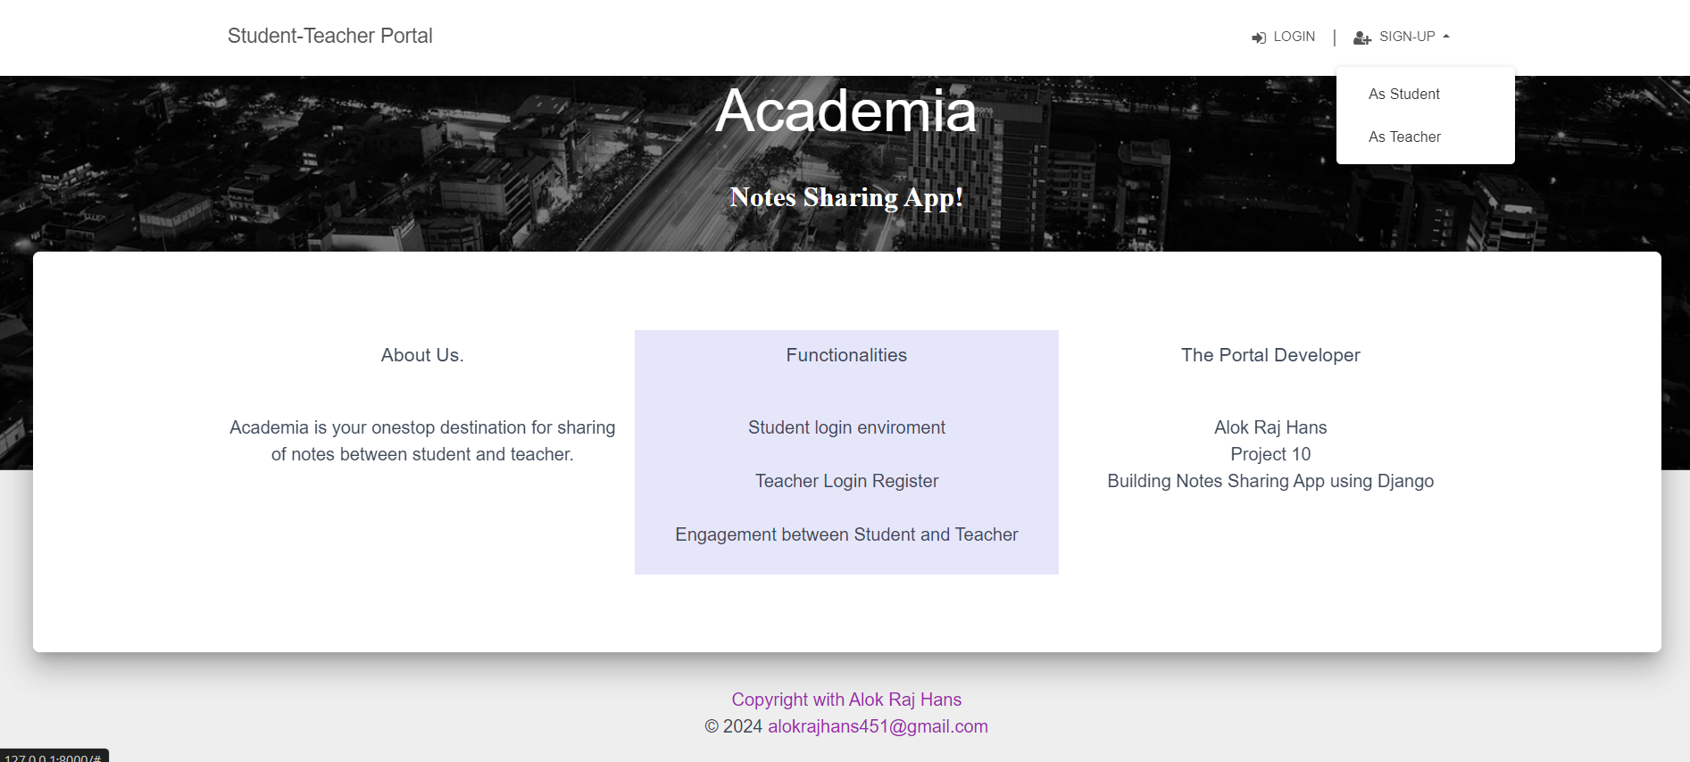
ACADEMIA

Slide 7
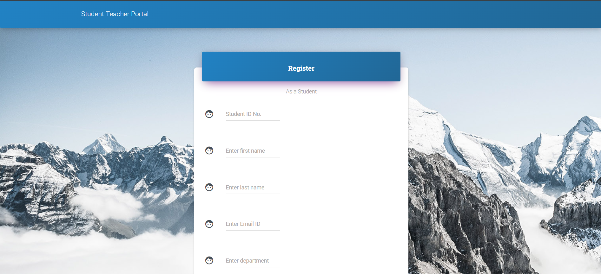


STUDENT REGISTER PORTAL!
ACADEMIA

Slide 8
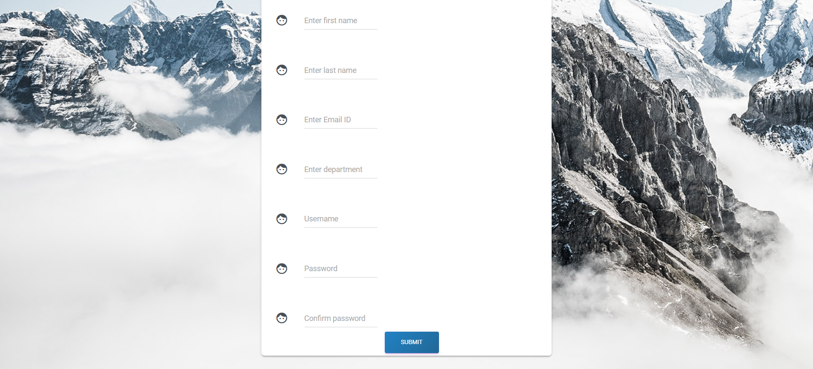
STUDENT REGISTER PORTAL!
ACADEMIA

Slide 9

TEACHER REGISTER PORTAL!
ACADEMIA

Slide 10
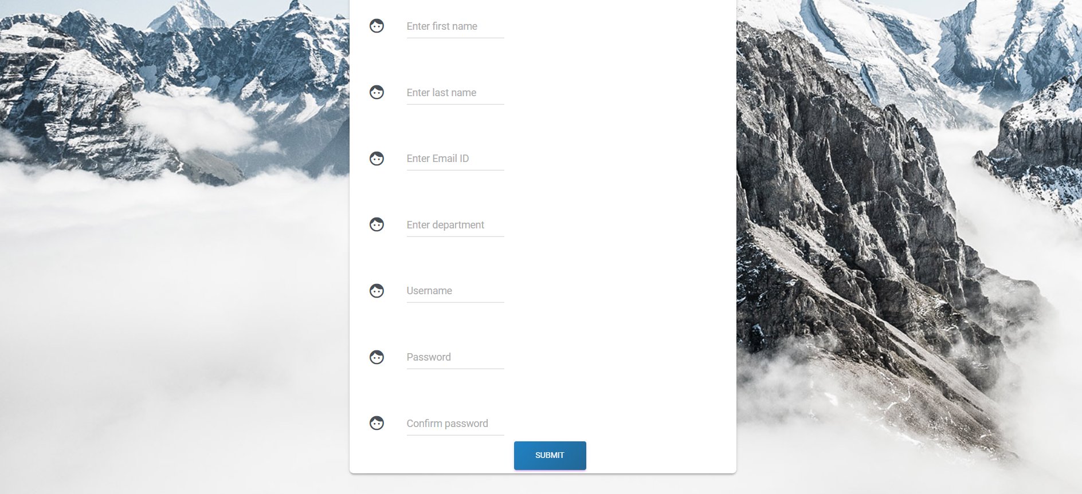
TEACHER REGISTER PORTAL!
ACADEMIA

Slide 11
LOG IN
ACADEMIA
02

Slide 12
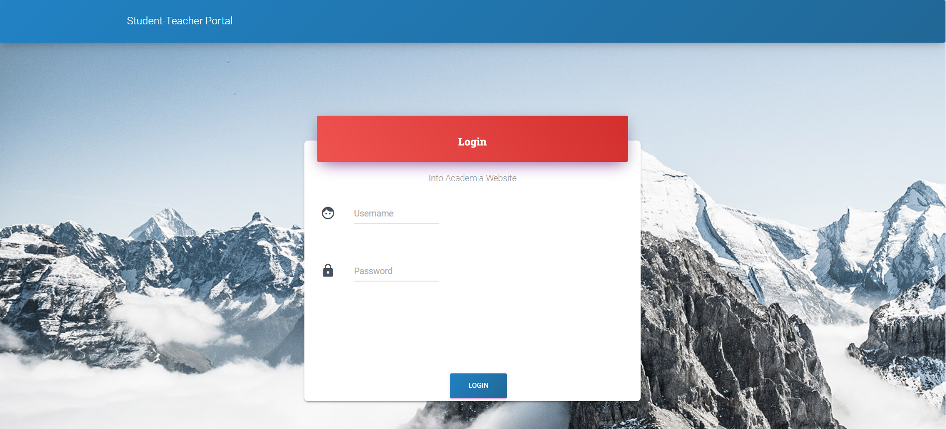
LOG IN!
ACADEMIA

Slide 13
Multiple dashboard
ACADEMIA
student
teacher
Includes all information of student with the notes shared by respective teacher
Includes all information of student with the field where notes can be uploaded

Slide 14
STUDENT DASHBOARD
ACADEMIA
03

Slide 15
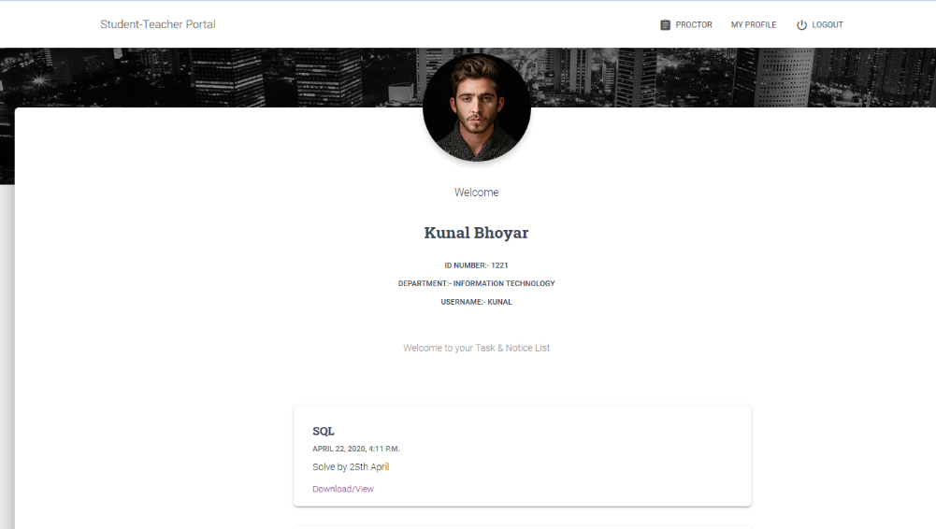
STUDENT DASHBOARD!
ACADEMIA

Slide 16
TEACHER DASHBOARD
ACADEMIA
04

Slide 17
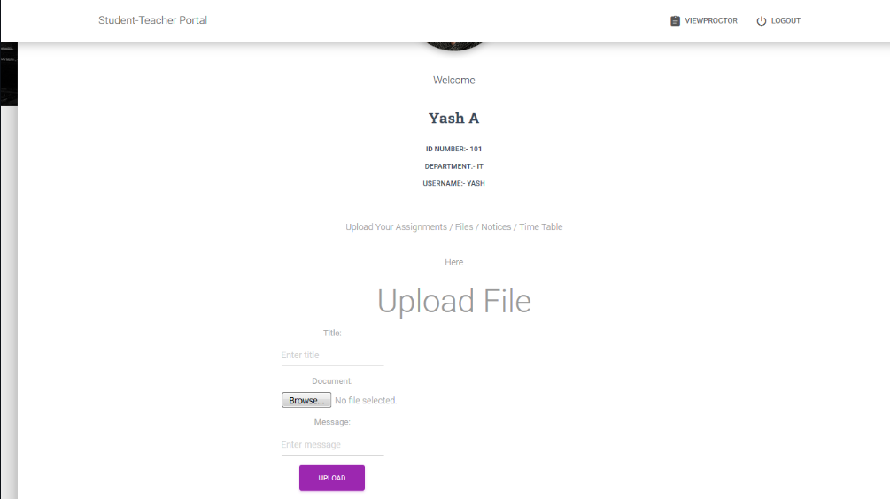
TEACHER DASHBOARD!
ACADEMIA

Slide 18
Key factors of using Academia
ACADEMIA
platform
accessibility
One stop platform for both student to access and teacher to share the notes!
Notes can be accessed any time any where!
structured
efficient
Department wise notes shared and accessible
Less time consuming and hassle free sharing of notes

Slide 19
Uploading/ downloading TIMELINE
ACADEMIA
In mins | 00:00 | 01:00 | 01:30 | 02:00 | 02:02
Sign up
Log In
Scrolling to the desired section
Uploading/ Downloading the Notes

Slide 20
THANKS to all!
ACADEMIA
ALOK RAJ HANS
alokrajhans451@gmail.com
STU6438146bbd4d61681396843
@withmeallok
/withmeallok

